Slide 1
ENGLISH PREMIER LEAGUE
Analysis
2023-2024 season

Slide 2
Introduction
In this project, various aspects of team and player performances in the league is analyzed. Our analysis covers multiple dimensions including stadium attendance, team performance, goal scoring, expected goals, goalkeeper performance, passing statistics, shooting analysis, and defensive actions. By diving into these metrics, we aim to provide a comprehensive overview of the strengths and weaknesses of teams and key players.
Data Collection
The data for this analysis was collected primarily from fbref.com and supplemented by other reputable sources. The data includes detailed statistics on team performances, individual player metrics, and game outcomes.
Data and Tools
A total of 7 tables has been used in this analysis:
Pl_Table - Contains overall league standings and team statistics.
Players - Includes detailed statistics for individual players.
Stadiums_and_Attendance - Records data on stadium capacities and match attendances.
Squad_Shooting - Provides insights into team shooting statistics. Squad_Advanced_Goalkeeping - Captures advanced metrics related to goalkeeper performance.
Squad_Defensive_Actions - Details team defensive actions and metrics.
Squad_Passing - Contains data on various passing metrics for teams.
The analysis was performed using MySQL Workbench, which enabled us to manage and query the data efficiently.

Slide 3
Presentation Overview
The presentation is structured into the following sections:
Stadium and Attendance - Analysis of stadium capacities and match attendance.
Team Performance Analysis - Evaluation of overall team performance metrics.
Top Strikers/Goal Scorers - Identification of the top goal scorers in the league.
Expected Goals (XG) Analysis - Insights into teams' and players' expected goals.
GK Performance & Playing Style - Analysis of goalkeepers' performances and
styles.
GK Effectiveness & Sweeper Keeper - Evaluation of goalkeeper effectiveness and sweeper keeper metrics.
Passing Categorization and Statistics - Detailed analysis of team passing.
Advanced Passing Statistics - Insights into advanced passing metrics.
Squad Shooting Analysis - Comprehensive look at team shooting performances.
Defensive Actions - Evaluation of team defensive actions.
Defensive Errors & Interceptions - Analysis of defensive errors and interceptions.
Key Players and Team Metrics - Identification of key players and their contributions.
Additional Key Players - Further insights into important players.
Performance Metrics - Summary of various performance metrics across teams and players.

Slide 4




Stadium and Attendance
Top 5 Teams by Average Attendance
Finding: Arsenal, Manchester United, etc. have the highest average attendance.
Table displaying the top 5 teams and their average
attendance.
Rank | Team | Stadium | Average Attendance
1 | Man Utd | Old Trafford | 64,880
2 | Arsenal | Emirates Stadium | 51,502
3 | West Ham | London Stadium | 49,384
4 | Tottenham | Tottenham Hotspur Stadium | 44,576
5 | Newcastle | St. James' Park | 44,495
Teams Filling Stadiums Above 90% (Capacity minimum
25000)
Finding: Team like Arsenal consistently fill their stadiums above 90%.

Slide 5












Team Performance Analysis
Qualification for European Competitions
Finding: Teams like Manchester City, Arsenal, Aston Villa and Liverpool have qualified for the Champions League. Tottenham and Chelsea qualified for Europa league. Newcastle got a place in Conference League.
Teams with Best Goal Difference
Finding: Manchester City and Arsenal has the highest goal
difference, indicating a strong offense and defense.
Rank | Team | Goal Difference (GD)
1 | Manchester City | 62
2 | Arsenal | 62
3 | Liverpool | 45
4 | Newcastle Utd | 23
5 | Aston Villa | 15
Teams with Most Goals Scored and Less Goals Conceded
Finding: Manchester City has the highest goal scoring and Arsenal has conceded fewest goal showcasing their best offensive and defensive ability.

Slide 6

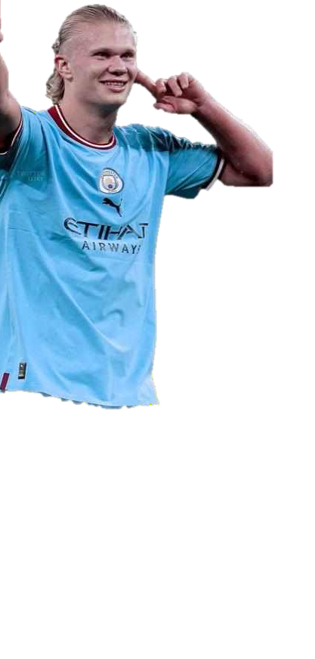






Top Strikers/ Goal Scorers
Top 5 Goal Scorers of PL 23-24 Season
Erling Haaland from Manchester City is the top scorer with 27 goals.
Cole Palmer from Chelsea scored 22 goals, securing the second position.
Alexander Isak from Newcastle Utd scored 21 goals, coming in third.
Ollie Watkins from Aston Villa and Dominic Solanke from
Bournemouth both scored 19 goals, tying for the fourth spot.
Mohamed Salah from Liverpool scored 18 goals, placing him in fifth position.
Rank | Player | Goals | Team
1 | Erling Haaland | 27 | Manchester City
2 | Cole Palmer | 22 | Chelsea
3 | Alexander Isak | 21 | Newcastle Utd
4 | Ollie Watkins | 19 | Aston Villa
4 | Dominic Solanke | 19 | Bournemouth
5 | Mohamed Salah | 18 | Liverpool

Slide 7




Expected Goals (XG) Analysis
Best XG Performance
The team with the highest expected goals (XG) in the Premier League 2023-2024 season is Liverpool. However, they scored lesser than expected based on their XG.
Top 5 Teams Who Scored More than Expected
These teams scored more goals than expected, indicating potential over performance or good fortune.
Rank | Team | Lucky Goals/Unexpected Goals
1 | Manchester City | 15
1 | Arsenal | 15
2 | Aston Villa | 13
3 | Luton Town | 10
4 | Newcastle Utd | 9
5 | West Ham | 8
5 | Crystal Palace | 8

Slide 8




Expected Goals (XG) Analysis Contd..
Top 5 Teams Who Scored Less than Expected
These teams scored fewer goals than expected, indicating potential inefficiency in their attack or bad luck.
Rank | Team | Goals Missed Out
1 | Everton | 14
2 | Sheffield Utd | 3
3 | Liverpool | 2
3 | Brighton | 2
3 | Bournemouth | 2
3 | Brentford | 2
4 | Nott'ham Forest | 1
The above table implies how many chances Everton missed out.
Teams Scoring as Expected
Table of teams who scored exactly as expected.
Rank | Team | Diff (Goals Scored as Expected)
1 | Burnley | 0
Burnley is the Only team that scored as expected.

Slide 9
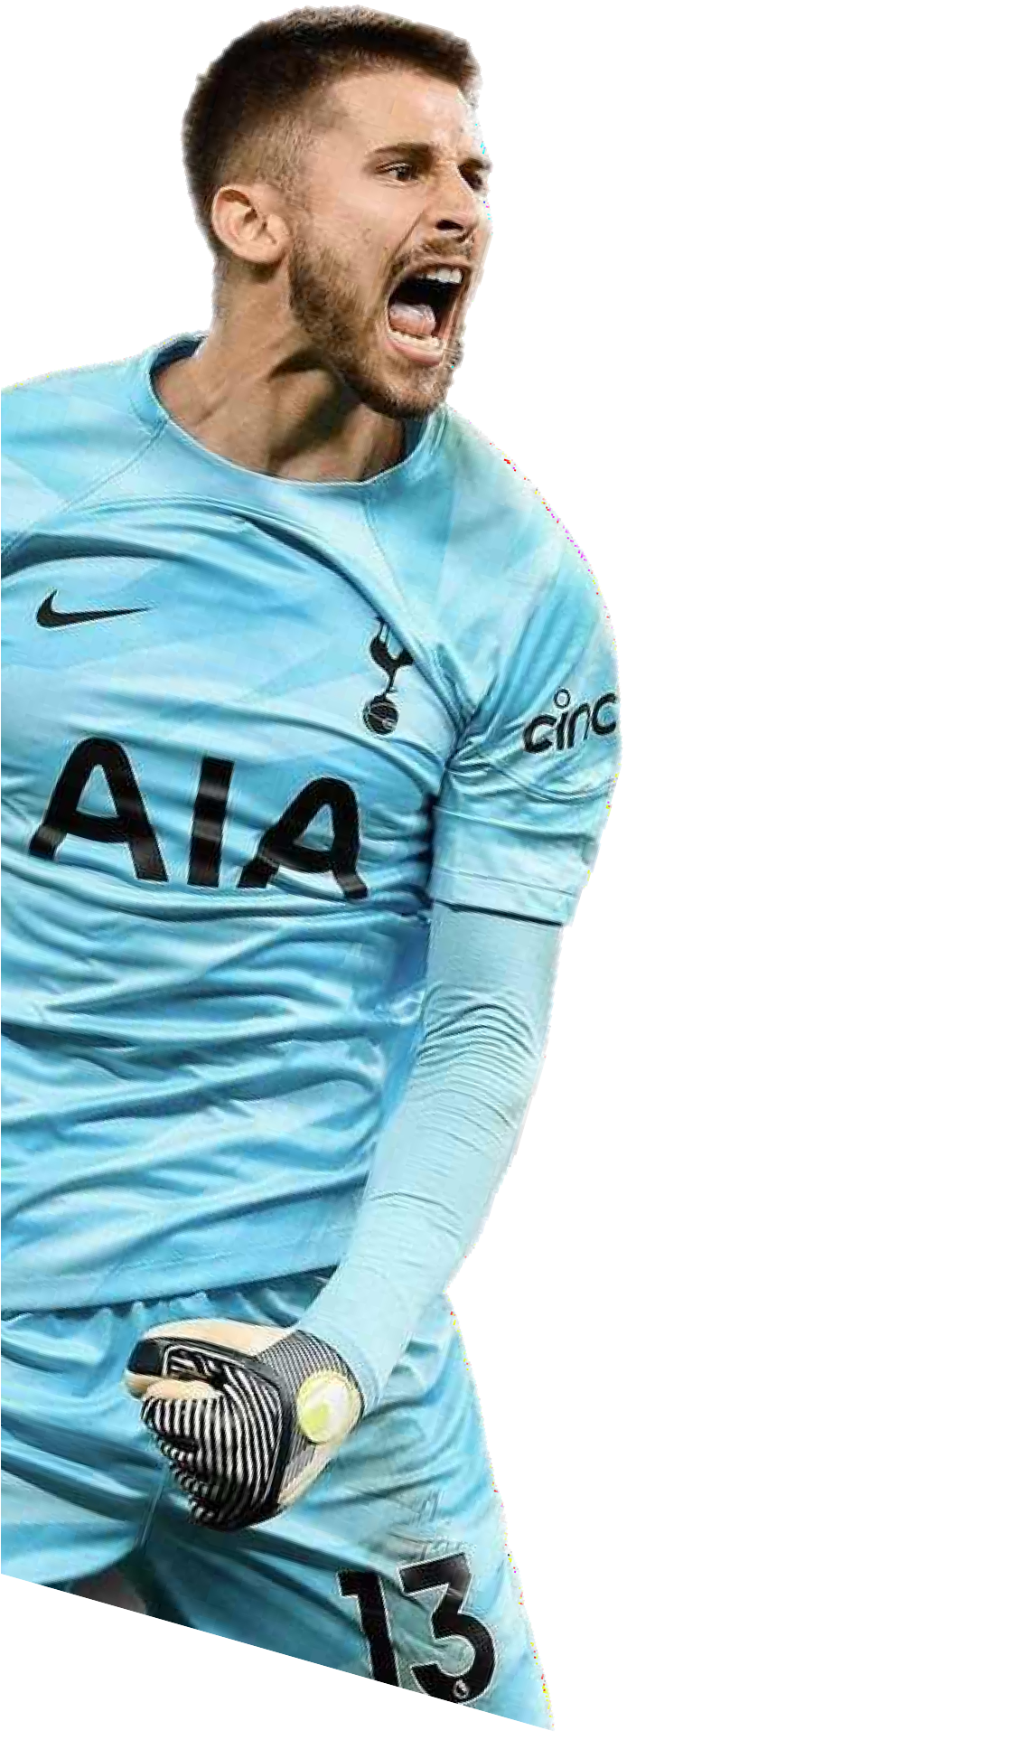
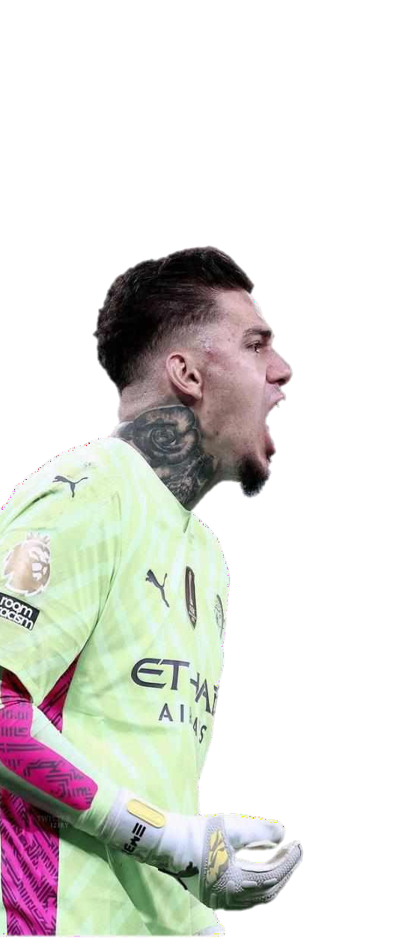


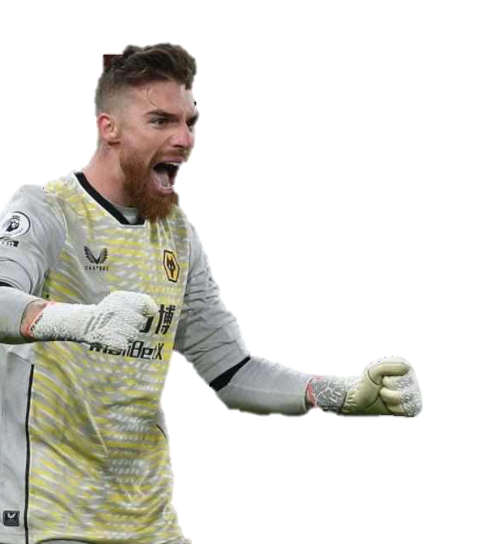




GK Performance & Playing Style
Teams Conceded Fewer Goals than Expected (Overperforming Goalkeepers)
Team | Less Goals Conceded
Wolves | 7
Manchester City | 2
Aston Villa | 1
Everton | 1
Manchester Utd | 1
Teams with the Fewest Ball Launches (Prefer Positional Play)
Rank | Team | Launch Attempts | Completion Percentage
1 | Tottenham | 225 | 23.6%
2 | Brighton | 274 | 37.2%
3 | Liverpool | 285 | 32.3%
4 | Newcastle Utd | 301 | 33.2%
5 | Manchester City | 314 | 45.2%
Teams with the Highest Average Passing Range by Goalkeepers
Team | Average Passing Range (Yards)
Luton Town | 50.8
Bournemouth | 41.7
Everton | 41.6
Crystal Palace | 41.2
Sheffield Utd | 41.2

Slide 10
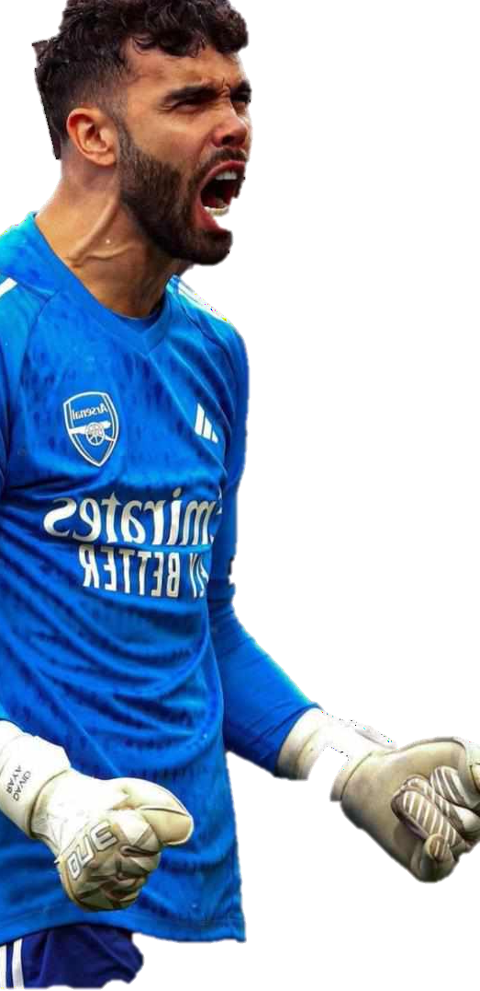


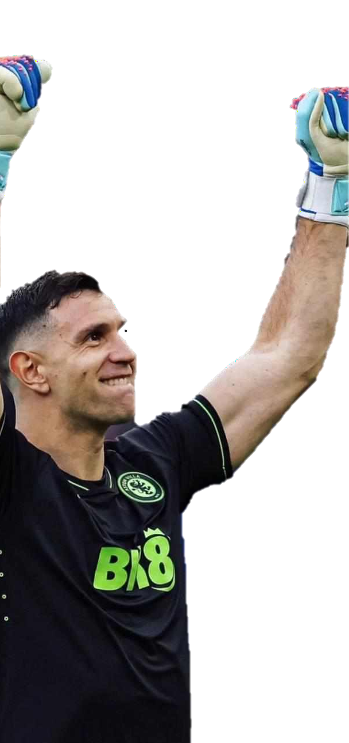
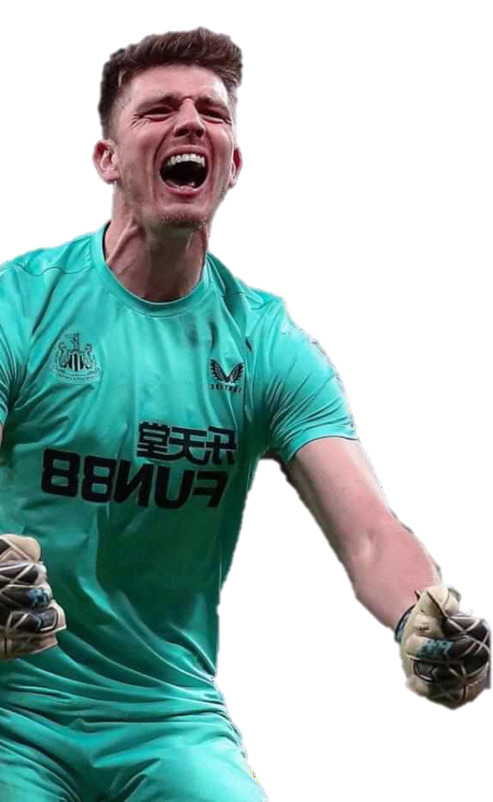


GK Effectiveness & Sweeper Keeper
Teams with Goalkeepers Stopping the Most Crosses
Team | Number of Crosses Stopped | Percentage of Shots Stopped
Aston Villa | 51 | 12.2%
Burnley | 50 | 8.9%
Arsenal | 48 | 12.8%
Brentford | 46 | 7.6%
Wolves | 45 | 7.9%
Best Sweeper-Keepers (Defensive Actions Outside the Penalty Area)
Team | Number of Defensive Actions Outside Penalty Area | Average Distance Covered Outside Penalty Area (Yards)
Newcastle Utd | 53 | 19.5
Luton Town | 77 | 19.0
Arsenal | 59 | 17.9
Liverpool | 46 | 17.7
Manchester City | 63 | 17.3
Team with the Best Percentage of Crosses Stopped by Goalkeepers
Team | Percentage of Crosses Stopped
Arsenal | 12.8%

Slide 11

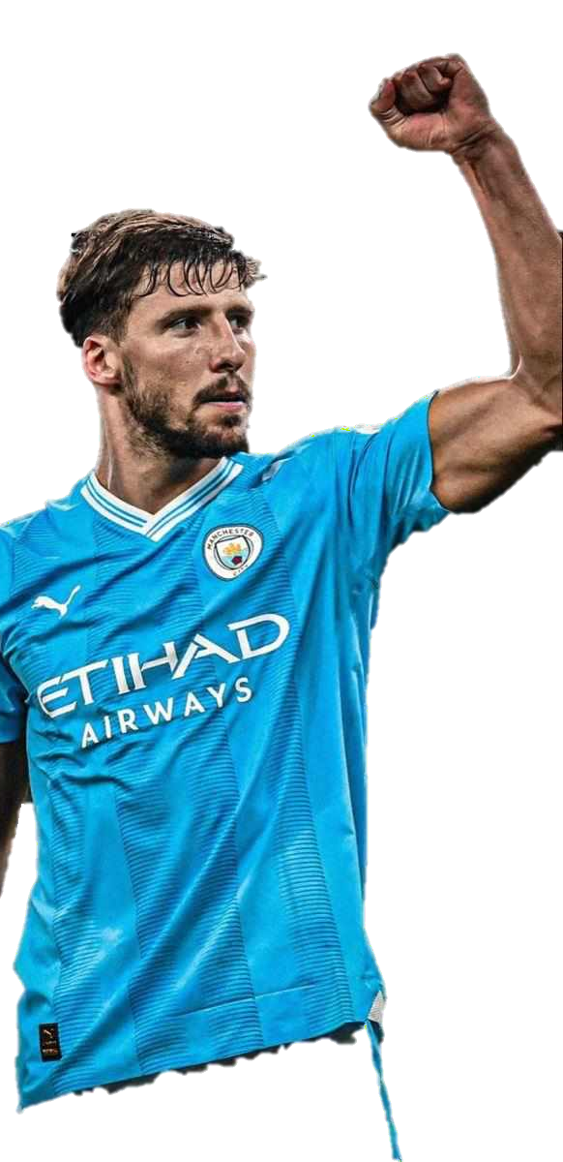
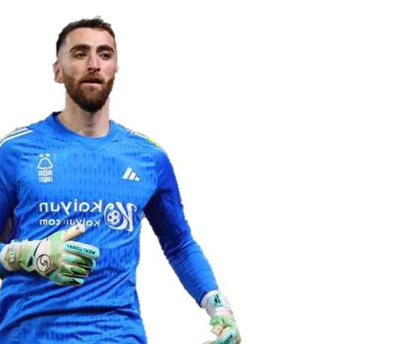


Defensive and Goalkeeper Stat.
Teams Conceded the Fewest Own Goals
Rank | Team | Own Goals Conceded
1 | Brentford | 0
Teams Conceded the Lowest Number of Set Piece Goals (Corners + Free Kicks
Rank | Team | Set Piece Goals Conceded
1 | Manchester City | 3
Teams Conceded More Goals than Expected (Underperforming GK) Based on PSxG(Post-Shot expected Goals)
Team | Excessive Goals Conceded
Nott'ham Forest | 20
Sheffield Utd | 19
Brighton | 11
Chelsea | 10
Crystal Palace | 10

Slide 12

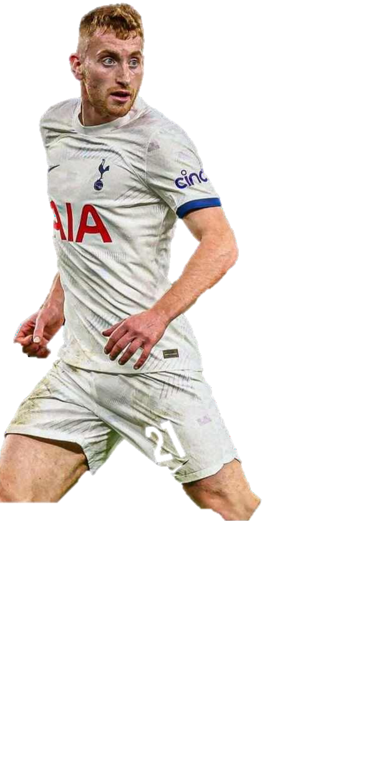





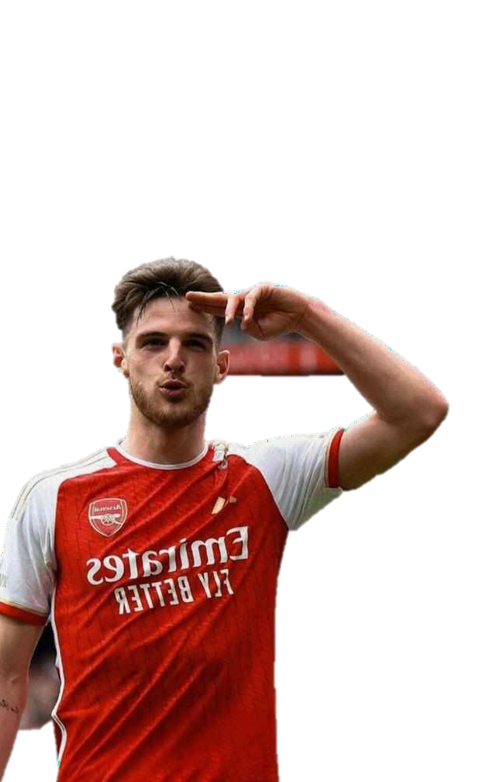






Passing Categorization and Stat.
Top 3 Teams with Best Passing Accuracy (Among Top 10 in most Pass Completion)
Manchester City, Brighton and Chelsea with a accuracy of 88.7,87.1 and 85.1 respectively.
Top 3 Teams with Most Short Passes (5-15 yards) (Accuracy > 90%)
Rank | Team | Short Passes Attempted | Accuracy (%)
1 | Manchester City | 13721 | 94
2 | Brighton | 12473 | 92.8
3 | Tottenham | 11617 | 91.5
•
Top 3 Teams with Most Medium Passes (15-30 yards) (Accuracy > 85%)
Rank | Team | Medium Passes Attempted | Accuracy (%)
1 | Manchester City | 10306 | 91.7
2 | Liverpool | 9763 | 88.4
3 | Tottenham | 9345 | 89.5
Top 5 Teams with Most Long Passes (Over 30 yards) (Accuracy > 50%)
Rank | Team | Long Passes Attempted | Accuracy (%)
1 | Manchester City | 2498 | 66.1
2 | Liverpool | 2814 | 58.2
3 | Fulham | 2853 | 55.6

Slide 13





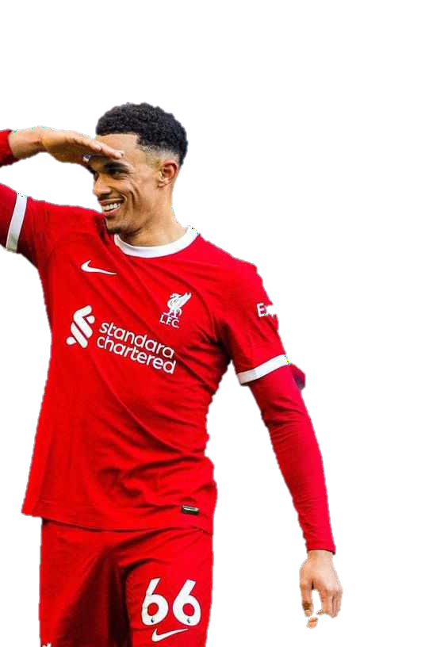






Advanced Passing Stat.
Top 3 Teams with Most Key Passes (Passes Leading to a Shot on Goal)
Rank | Team | Key Passes
1 | Liverpool | 598
2 | Manchester City | 545
3 | Arsenal | 513
Top 3 Teams with Most Passes Completed in Final Third
Rank | Team | Final Third Passes
1 | Manchester City | 1890
2 | Liverpool | 1666
3 | Tottenham | 1588
•
Top 5 Teams with Most Crosses into Opponent's Penalty Area
Rank | Team | Crosses into Penalty Area
1 | Brentford | 106
2 | Fulham | 94
3 | Luton Town | 90
4 | Bournemouth | 88
5 | Brighton | 81

Slide 14

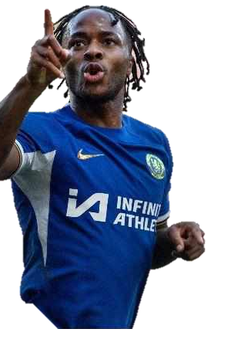

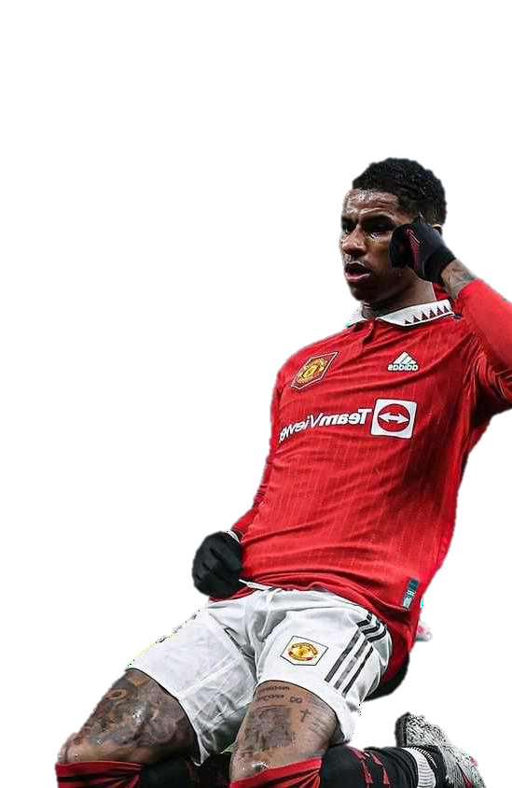

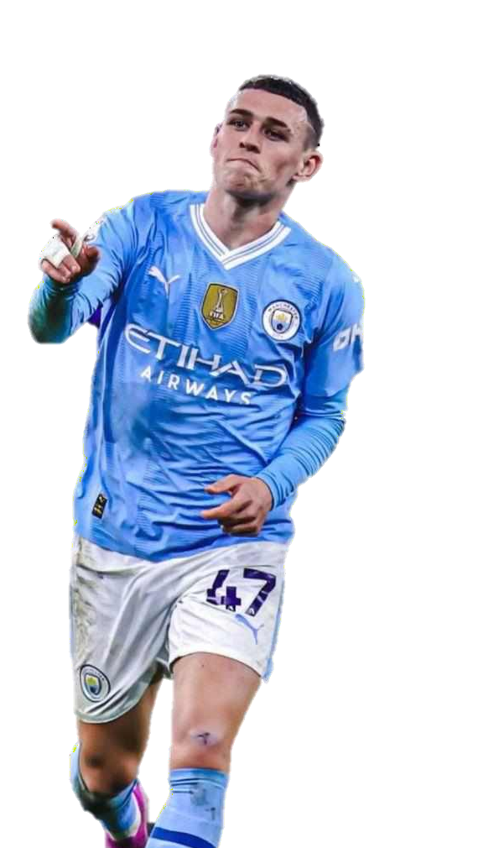






Squad Shooting Analysis
Top 3 Teams with Best Shooting Accuracy
(Percentage of successful shots on target)
Rank | Team | Total Shots | Shooting Accuracy (%)
1 | Manchester City | 683 | 38.7
2 | Newcastle Utd | 542 | 36.2
3 | Chelsea | 537 | 36.1
Top 3 Teams with Best Shots on Target per 90 Minutes
Rank | Team | Shots on Target per 90 Minutes
1 | Manchester City | 6.95
2 | Liverpool | 6.92
3 | Arsenal | 5.5
Top 3 Teams with Longest Average Shooting Distance
(in Yards)
Rank | Team | Average Shooting Distance (Yards)
1 | Burnley | 17.7
2 | Manchester Utd | 17.4
2 | Sheffield Utd | 17.4
3 | Chelsea | 17.3

Slide 15



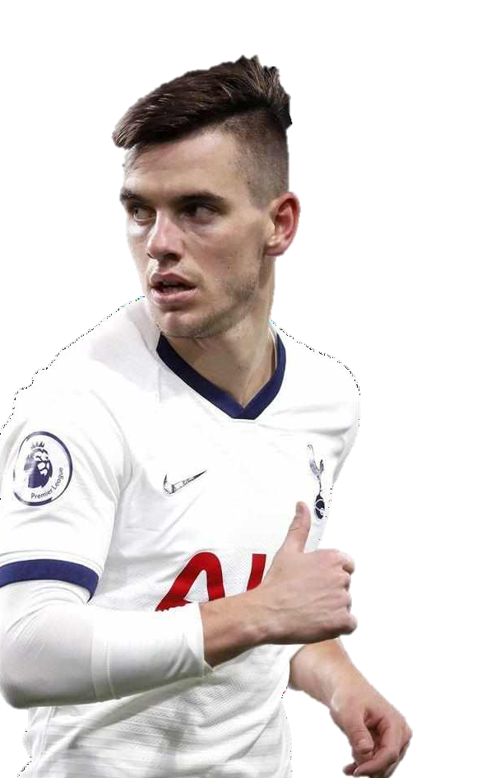



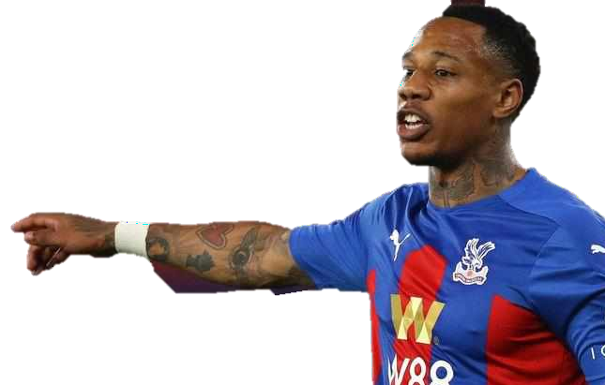




Defensive Actions
Top 3 Teams with Most Tackles in Defensive Third:
Rank | Team | No of Tackles in Def 3rd
1 | Nott'ham Forest | 437
2 | Wolves | 415
3 | Sheffield Utd | 375
Top 3 Teams with Most Tackles in Midfield:
Rank | Team | No of Tackles in Midfield
1 | Crystal Palace | 301
2 | Liverpool | 290
3 | Bournemouth | 281
Top 3 Teams with Most Tackles in Attacking Third:
Rank | Team | No of Tackles in Att 3rd
1 | Tottenham | 125
2 | Crystal Palace | 114
3 | Liverpool | 113
3 | Manchester City | 113

Slide 16

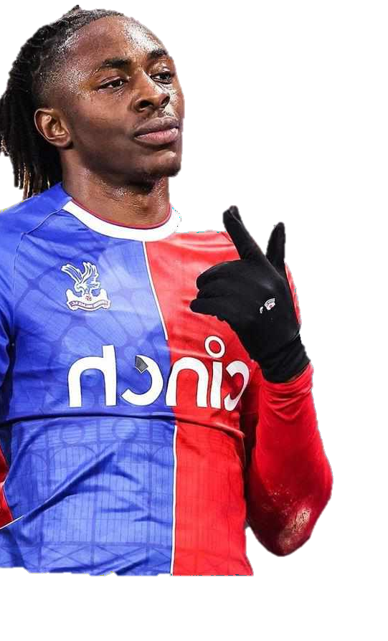

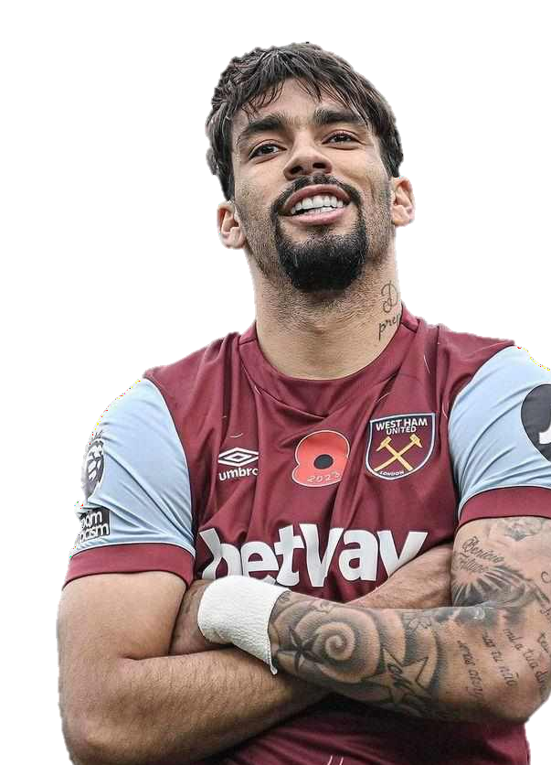






Defensive Errors & Interceptions
Top 3 Teams with Best Successful Tackle Rate:
Crystal Palace (55.3%), Nott'ham Forest (53.5%), and Tottenham(52.1%) have the highest percentage of successful tackles, indicating effective defensive efforts and a strong ability to win the ball from opponents.
Top 3 Teams with Most Errors Leading to Opponent's Shots: Chelsea and Tottenham have committed the most errors leading to opponents' shots, highlighting
potential weaknesses in their defensive play that could be targeted by opponents.
Rank | Team | No of Errors Leading to Shots
1 | Chelsea | 24
1 | Tottenham | 24
2 | Burnley | 22
3 | Brighton | 21
Top 3 Teams with Most Interceptions:
Rank | Team | No of Interceptions
1 | Brentford | 378
2 | Fulham | 371
3 | West Ham | 361

Slide 17

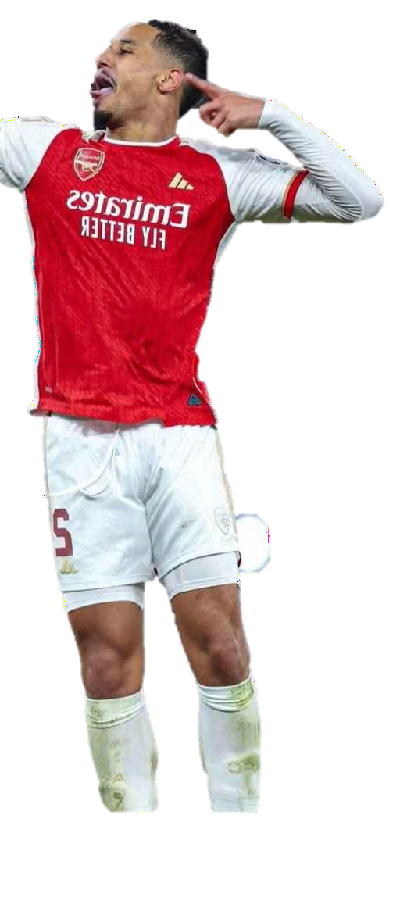


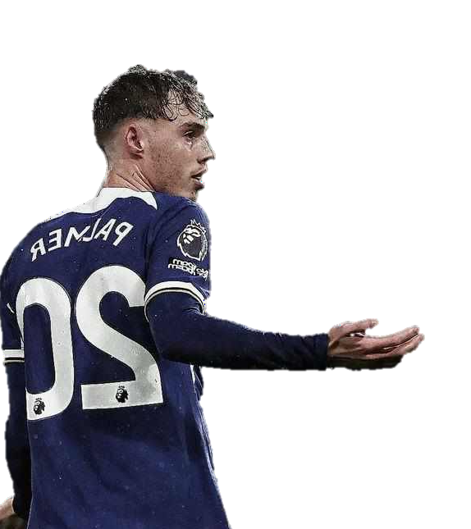


Key Players and Team Matrices
Youngest Team
Chelsea: The youngest team with an average age of 22.03 years.
Top 3 Highest Goal Scorer from Each Club
Example For Arsenal:
Bukayo Saka: 16 goals
Kai Havertz: 13 goals Leandro Trossard: 12 goals
Players that Played All 38 League Matches (Excluding Goalkeepers)
Player | Squad | Position
Declan Rice | Arsenal | MF
William Saliba | Arsenal | DF
Moussa Diaby | Aston Villa | FW, MF
Dominic Solanke | Bournemouth | FW
Vitaly Janelt | Brentford | MF, DF
Joachim Andersen | Crystal Palace | DF
James Tarkowski | Everton | DF
Carlton Morris | Luton Town | FW, MF
Max Kilman | Wolves | DF

Slide 18



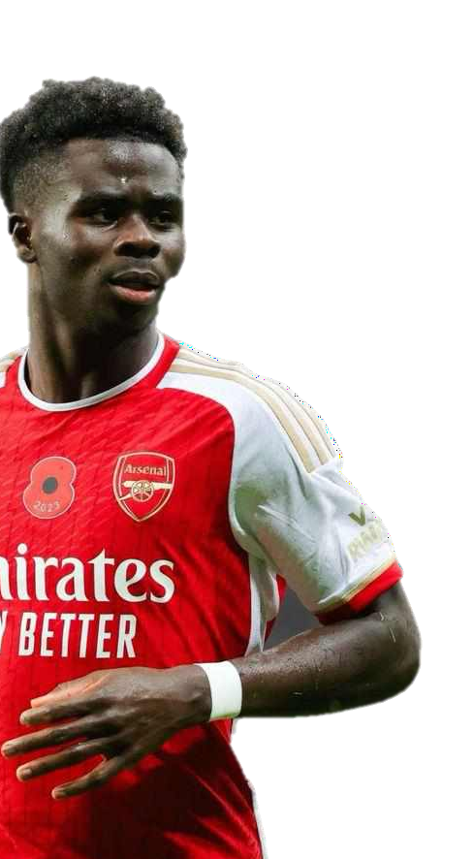






Additional Key Players
Top 3 Players That Created Most of the Chances
Rank | Team | Player | Chances Created
1 | Manchester Utd | Bruno Fernandes | 413
1 | Tottenham | Son Heung-min | 413
2 | Liverpool | Mohamed Salah | 378
3 | Arsenal | Bukayo Saka | 368
Top 3 Best Carriers of the Ball
These players significantly impact offensive play by advancing the ball, creating scoring opportunities, and maintaining possession.
Rank | Player | No of Carries | Squad
1 | Jeremy Doku | 218 | Manchester City
2 | Alejandro Garnacho | 178 | Manchester Utd
3 | Bukayo Saka | 155 | Arsenal
Top 3 Players with the Most Progressive Passes (at least 10 yards)
Rank | Player | No of Progressive Passes | Squad
1 | Rodri | 376 | Manchester City
2 | Martin Odegaard | 344 | Arsenal
3 | Pascal Groa | 302 | Brighton

Slide 19

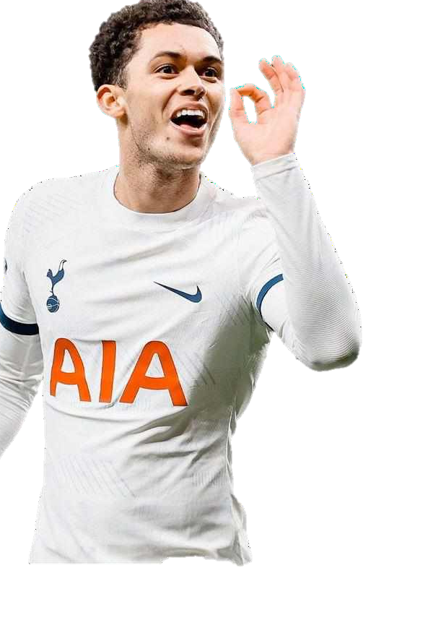

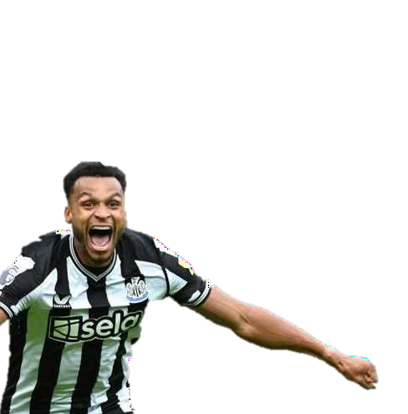

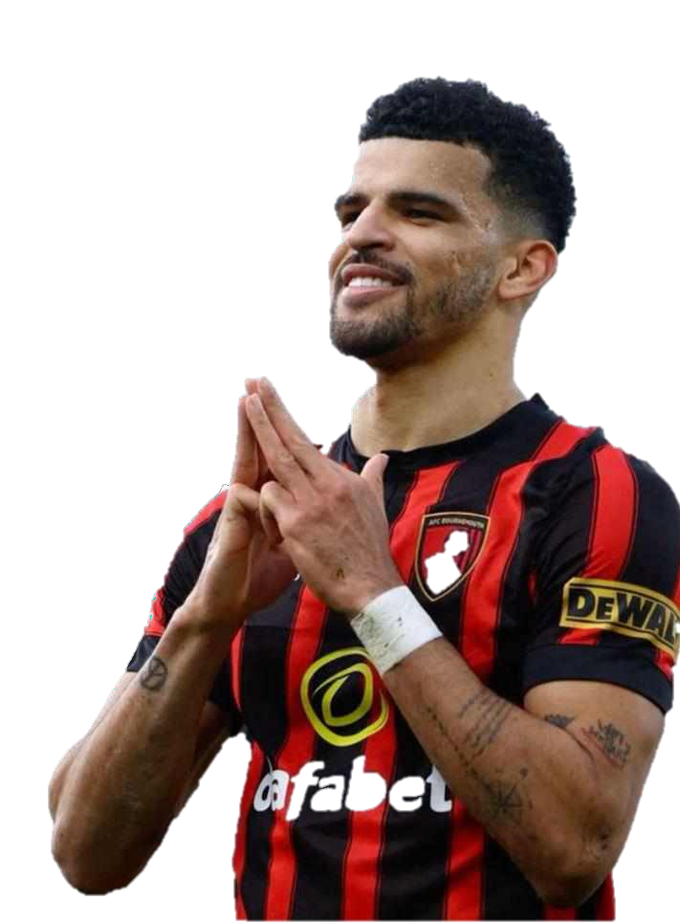






Performance Metrics
Top 3 Players with Most No of Assists per 90 Minutes (>20 Matches)
Rank | Player | Assist Per 90 | Squad
1 | Jacob Murphy | 0.53 | Newcastle Utd
2 | Jeremy Doku | 0.45 | Manchester City
3 | Brennan Johnson | 0.43 | Tottenham
Top 3 Players with Most Non-Penalty Goals
Rank | Squad | Player | Non-Penalty Goals
1 | Manchester City | Erling Haaland | 20
2 | Manchester City | Phil Foden | 19
2 | Aston Villa | Ollie Watkins | 19
3 | Bournemouth | Dominic Solanke | 17
Top 3 Players with Most Penalty Goals
Rank | Squad | Player | Penalty Goals
1 | Chelsea | Cole Palmer | 9
2 | Manchester City | Erling Haaland | 7
3 | Arsenal | Bukayo Saka | 6

Slide 20
Thank You

